Slide 1
Definition of VARIABLE…
A symbol that represents a number.
“S” stands for the side-length of a square.
What is the perimeter?
What is the area

Slide 2
Equations: Definition
x
A statement that the values of two mathematical expressions are equal (indicated by the sign =)
5x-2x=7
M+7=14
4x+3=11
18÷y=2
x²=25
7n-14=0

Slide 3
Equations: Important to remember
Every occurrence of a variable in an equation has the same value!
5N+2N=12+2N
5M+2M=14+2M
5a-2=7+9a

Slide 4
Check to see if this is a solution…
M+12=20
IS 12 a solution? How do you know?
N+7=14
IS 7 a solution? How do you know?
2M+1=14
IS -1 a solution? How do you know?

Slide 5
Combining “like” Terms
12
5 + 7 =
5x + 7x =
12x
5x + 7x + 3x =
15x
5x + 7x + 3 =
12x + 3
On your own try:
2x + 4x + 5 = 7 + 2 + 6x + 3x =

Slide 6
Inequalities: Definition
A statement that the values of two mathematical expressions are NOT equal (indicated by the signs <, >, ≤, ≥, ≠)
X<5
3x ≥ 12
2N ≤ 7+N

Slide 7
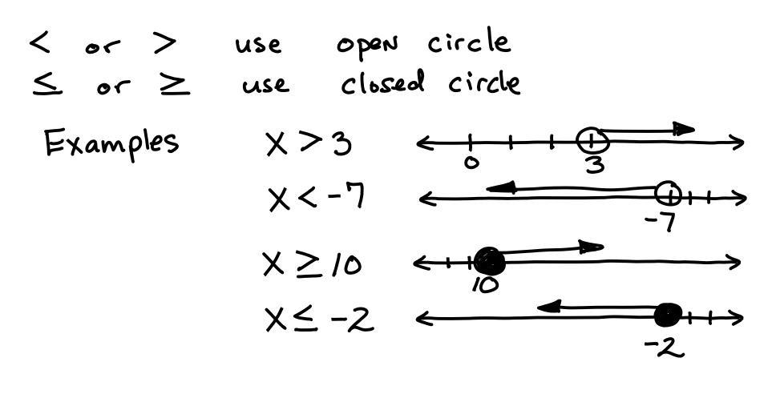
Inequalities
Inequalities can be expressed with symbols, words, or on a number line:
How would each of these be represented with words?

Slide 8
Write an algebraic equations or inequalities for these statements:
A number increased by nine is 20.
Twice a number is less than eighteen.
Four less than a number is 16.
A number divided by six is greater than or equal to 10.

Slide 9
Looking for Structure in Equations Look for shortcuts while trying to find values that would satisfy this equation
5x+3x=3x+15
8y-3y=16-3y
10N+2N=12+2N

Slide 10
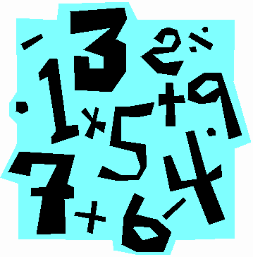
Warm-up
Write an algebraic equation for each of these statements then solve:
A number increased by nine is 20.
Twice a number is eighteen.
Four less than a number is 16.
A number divided by six is 10.

Slide 11
Warm-up
Complete the T-charts with 6 values… this time I gave you the pattern for x and you tell me the rest!
x
X+2
x
2X
1
3
1
2

