Slide 1
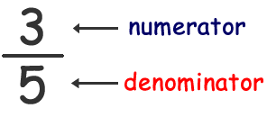
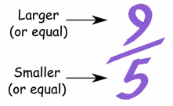
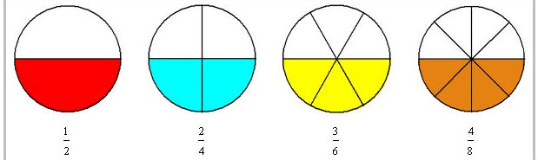
Key Terms
Numerator
Denominator
Improper Fraction
Mixed Number
Equivalent fractions
Simplest Form

Slide 2
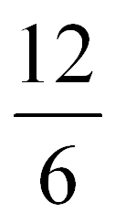
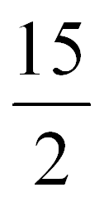
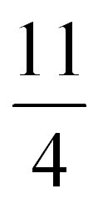
Warm-up
Convert the following improper fractions to MIXED NUMBERS!
Use any method!!!

Slide 3
Warm-up
What does it mean for a fraction to be “in simplest form”?
2. Write 5 fractions that are “in simplest form”.
3. Write 5 fractions that ARE NOT “in simplest form”.

Slide 4
Warm-up
These are equivalent fractions:
½ = 2/4
3/6
4/8
50/100
100/200
What do you notice about equivalent fractions?

Slide 5
Practice
10
÷2
5
1
?
÷5
?
=
=
30
15
3
÷2
÷5
8
÷2
4
÷4
?
1
?
=
=
24
12
3
÷2
÷4

Slide 6
Warm-up
What’s wrong with this?
+ =
Explain using pictures and full sentences…

Slide 7
Quick math notes
You can’t add/subtract fractions if their denominators are different because….
The pieces are different sizes!
Find a common denominator
Write equivalent fractions with your new denominator
Add/subtract the numerators... (keep the denominator)
Simplify…

Slide 8
Practice:
x10
10
24
34
1
2
x3
+
=
=
30
30
30
15
x10
x3
5
4
9
x5
x2
+
=
10
10
10
x5
x2

Slide 9
Quick math notes
Adding mixed numbers
The pieces are different sizes!
First add/subtract the whole numbers…
Then add/subtract the fractions
Simplify…

Slide 10
Practice
8
6 + 2 =
1
1
1
4
5
5
x4
+
=
+
=
=
8
2
8
x4
8
8
8

Slide 11
Borrowing…
What do you think of when you hear borrowing???
Could borrowing come in handy with fractions??? When? Give an example if you can.

Slide 12
Practice
1
1
2
+8=9
3
1
3
1
1
4
-
x4
=
-
8
2
8
8
x4
<
So… We need to borrow!
2
9
1
4
5
-
=
8
8
8
=
1
-
=

Slide 13
Borrowing…
Find a common denominator
Write equivalent fractions with new denominator
If fraction one is smaller than fraction two:
Take away one from the whole number
Add the denominator to the numerator
Keep the denominator the same
Rewrite your new problem
Subtract the whole numbers
Subtract the fractions
Simplify

Slide 14
Practice
1
2
3
+12=14
4
x2
1
4
2
1
8
-
x4
=
-
6
3
12
12
x2
x4
3
14
1
8
6
1
-
=
=
12
12
12
2
=
2
-
=

Slide 15
Warm-up
+
=
Given the numbers 1, 2, 3, and 4, which boxes should you put them in to get the MAXIMUM sum?
Explain why the order you chose creates the largest sum.

Slide 16
Warm-up
What fraction of this class is boys?
What fraction of this class is girls?
What fraction of the people in room class are older than 20?
What fraction of the people at your table are 12?
(make a hypothesis…)What fraction of the people in this school are 12?

Slide 17
Warm-up
During the Monday Night Football game, the following commercials were shown:
5 commercials advertising long distance phone companies
18 commercials advertising beer
7 commercials advertising cars
11 commercials advertising insurance
9 commercials advertising fast food restaurants
1. What fraction of the commercials were for cars?
What fraction of the commercials were for beer?
3. What fraction of the commercials were for cars and beer?
What fraction of the commercials were for food or drink items?
If each of the commercial is 1 minute long and the going rate during football games is $10,000 per 30 seconds, how much money was made for these 50 commercials???

Slide 18
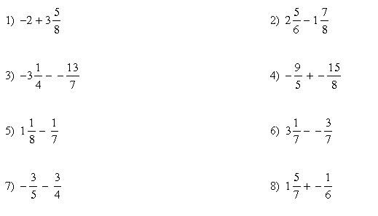
Warm-up
Take 2 minutes to ESTIMATE the following sums and differences…

Slide 19
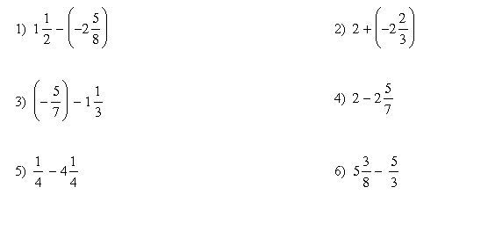
Warm-up
Look over your strategies from yesterday then take 2 minutes to ESTIMATE the following sums and differences…

Slide 20
Warm-up
Look over your strategies from yesterday then take 2 minutes to ESTIMATE the following sums and differences…

Slide 21
Warm-up
Look over your strategies from last week then take 2 minutes to ESTIMATE the following sums and differences…

