Slide 1
Norms for Consensus Discussion:
One hand, One voice
Use the hand signals
Respect:
Respect others while they are speaking
Respect others while I am speaking

Slide 2
Hand Signals

Slide 3
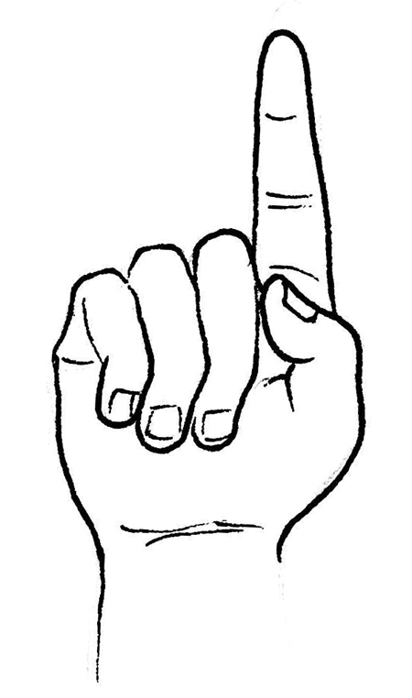
I have a new idea.

Slide 4
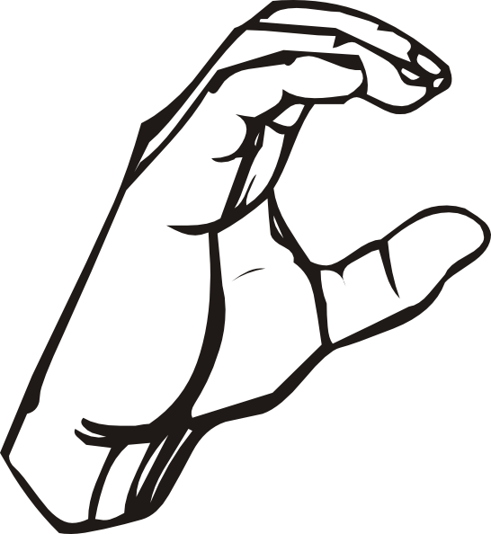
I have a comment or concern. (On someone else’s idea)

Slide 5
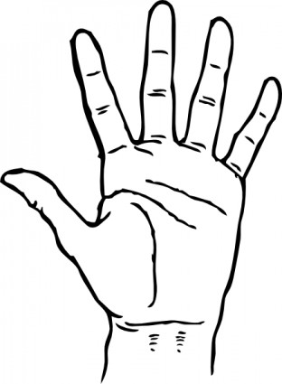
I have a question.

Slide 6
I support that idea!

