Slide 1
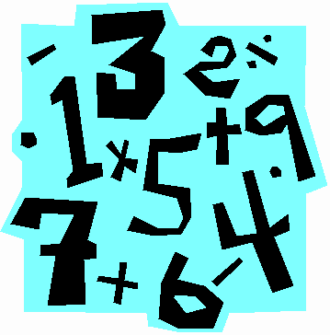
Distributive Property Warm-up
Explain what is happening in each of these boxes, then use a similar strategy to solve problem 1-3 below.
4 x 53
=4(50 + 3) =(4 x 50) + (4 x 3) =200 + 12 =212
4 x 27 =4(20 +7) =4(20) +4(7) =80 + 28 =108
7 x 67
8 x 91
5 x 142

Slide 2
Distributive Property!
What does “distribute” mean?

Slide 3
Distributive Property!
The Distributive Property (of Algebra) says:
a(b + c) = ab + ac

Slide 4
Distributive Property!
a(b + c) = ab + ac
How does this go along with our warm-up?
4 x 53
=4(50 + 3) =(4 x 50) + (4 x 3) =200 + 12 =212

Slide 5
Now with some variables…
Simplify the following expressions…
5 (2x - 3)
-7 (x + 2)
10 (2x - 5)
-6 ( -2m + 2)

Slide 6
Warm-up
Write five challenging expressions that can be simplified using the distributive property and then solve them!
Example (don’t use mine!) -7 (x + 2)
= (-7•x) + (-7•2)
=-7x + (-14)
Lastly, write one question you have about the distributive property!

