Slide 1
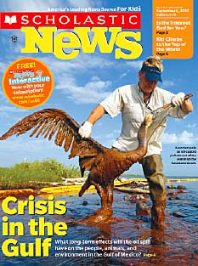
The Structure of a Feature Article

Slide 2
Project-Block Agenda
Feature Article Presentation
Feature Article Writing
Interview/Field Trip Phone Calls

Slide 3
What’s in a Feature Article?
Lead Sentence
Introduction
Opening Quotation
Main Body
Closing Quotation
Conclusion

Slide 4
Lead Sentence
Grab and hook your reader right away!

Slide 5
Introduction
Which facts and figures will ground your story? You have to tell your readers where and when this story is happening.

Slide 6
Opening Quotation
What will give the reader a sense of the people involved and what they are thinking?

Slide 7
Main Body
What is at the heart of your story?

Slide 8
Closing Quotation
Find something that sums the article up in a few words.

Slide 9
Conclusion
Closes the article with a memorable statement. Leaves the reader with something to think about.

Slide 10
Writing The Feature Article 1st Draft
Rough Draft
Rough Draft
Rough Draft
Your Group’s 1st Draft
Your Notes from today’s presentation

Slide 11
STEP BY STEP Writing The 1st Draft Feature Article
READ: Students share (read aloud) their articles. Look for common ideas and differences.
ANALYZE: Using the notes (“The Structure of A Feature Article”) students will identify the elements of a feature article that they’ve written. Label them in your journal.
PLAN: Students combine their articles to make one article.
CREATE: Students take turns typing the article on a laptop. Everyone in the group is involved in the writing. Use GOOGLE Docs and share the document with each person in the group & the teachers.

Slide 12
How do we include quotes?
Everyday, there are animals that are going extinct.
(We will include a quote about animal extinction from our interview with John Santos when he was talking about speciation here).
Therefore, because of speciation, there are also new types of animals being created every day as well. The problem is that more animals are going extinct than speciation can create.

