Slide 1
Fermi Problems

Slide 2
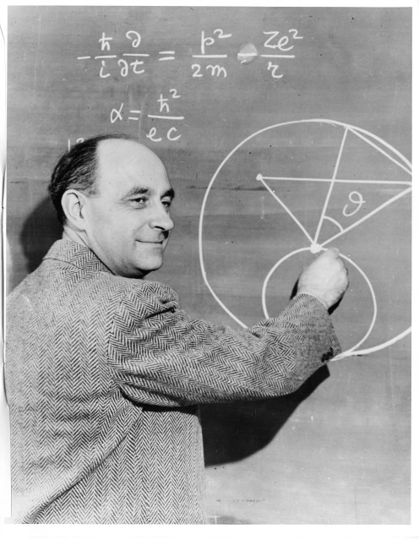
Who was Enrico Fermi?
Enrico Fermi is one of the most creative physicists of our times. He is best known for his contributions to nuclear physics. Fermi also loved to think up and discuss questions which involved a rough estimate of a quantity which would be difficult or impossible to measure directly.

Slide 3
What is a Fermi Problem?
http://www.youtube.com/watch?v=LKu0zWHl7_Y
An ESTIMATION problem

Slide 4
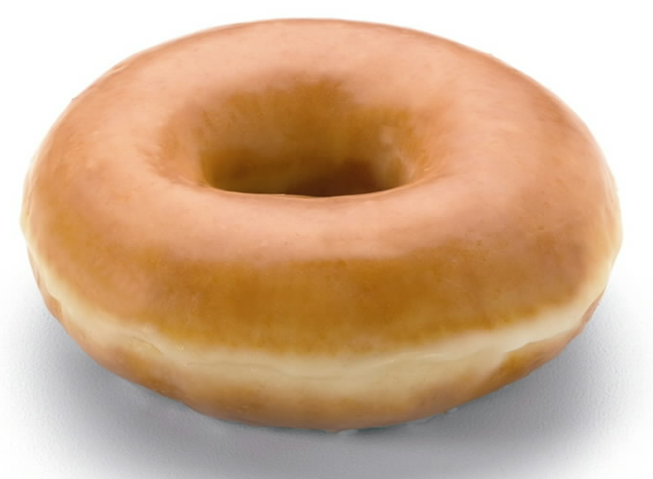
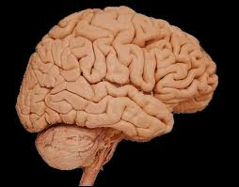
Examples of Fermi Problems:
How many donuts fit in a swimming pool?
How many pieces of paper does HTM use a day?
How many gallons of water would it take to fill up our classroom?
How many human brains equal the weight of an elephant?
How many times does your heart beat in a year?

Slide 5
What do you notice about these questions?
You can make a reasonable estimation to answer the question
It is not something that there is already an existing exact answer for
You can explain and justify your answer

