Slide 1
Fermi Project
Next steps...

Slide 2
Step 1:
From BIG ---> small
What is the small question that you need to answer in order to get at the bigger question?
example:
BIG question: How many water bottles would it take to wrap around the world?
small question: How many water bottles fit in 1 foot?

Slide 3
Step 2:
Write your "initial ratio" based on your measurement or computer research (this is the most important part to be accurate on!)
example:
1.5 water bottles
1 foot

Slide 4
Step 3:
Create a ratio table or double number line to model your initial ratio and other equivalent ratios of your choosing.
Water Bottles | 1.5 | 3 | 6 | 60 | 150 | ...
Feet | 1 | 2 | 4 | 40 | 100 | ...
Down our school hallway!
Across our classroom!
1.5
3
6
60
150
water bottles
feet
1
2
4
40
100

Slide 5
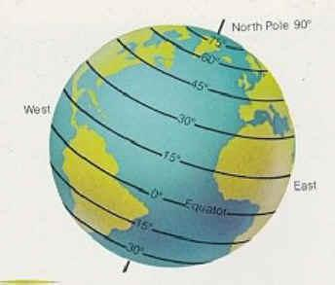
Step 4:
Extend your ratio table until you reach the value for your solution:
How many water bottles would it take to wrap around the world?
Subquestion: What is the distance around the world?
Answer from internet: 24,901.55 miles
Water Bottles | 1.5 | 3 | 6 | 60 | 150 | ???
Feet | 1 | 2 | 4 | 40 | 100 | 24,901.55 miles
But what about these units? .....

Slide 6
Converting Units
Somewhere along the way you may have to convert units because of the size of your numbers!
These may help you:
1 mile = 5280 ft
12 in = 1 ft
144 in² = 1 ft²
1728 in³ = 1 ft³
http://www.onlineconversion.com/length_common.htm can help you with any other conversions you might need... or ask your teacher for some help on this!

Slide 7
When you change units you will either need to...
Water Bottles | 1.5 | 150 | 7920 | 7,920,000
Feet | 1 | 100 | 5280 (1 mile)
Miles |  |  | 1 | 1000 | 24,901.55
Add a 3rd row onto your table
Water Bottles | 1.5 | 150 | 7920
Feet | 1 | 100 | 5280 (1 mile)
Create a second table with your new units
Water Bottles | 7920 | 7,920,000 | ???
Miles | 1 | 1000 | 24,901

Slide 8
Be careful with your dimension...
1D |  | measuring length "in a row" | in cm
2D |  | measuring area "cover a space" | in² cm²
3D |  | measuring volume "fit into" | in³ cm³

