Slide 1
Collaborative Design
What happens when students & teachers
design a PROJECT together?

Slide 2
Collaboratively Designed Project
The World
Your Life
Themes
PROJECT

Slide 3
?
?
It all starts here.
?
Your QUESTIONS.
?

Slide 4
Step 1: Questions About The World
?
What questions, concerns or wonders do you have about our world?
WRITE AS MANY QUESTIONS AS YOU CAN.
THIS SHOULD BE A SILENT ACTIVITY.
POST YOUR QUESTIONS ON YOUR TABLE (NAME IS ON EACH ONE).
EACH
STUDENT
WRITES
ONE
?
Per
STICKY
NOTE

Slide 5
Directions:
Double check that your name is on all of your sticky notes
On the envelop that a teacher gives you, write your first and last name
Put all of your questions into your folder
Place your folder in the center of your table in a pile for a teacher to collect

Slide 6
Categories Activity
From the basket the teacher passes around, select 7 objects
Put your 7 objects into two groups
Share with your table, how did you group your objects?
Now you need to make 3 different groups
Share with your table, how did you group your objects?

Slide 7
Categories Journal (In your Writer’s Notebook)
List as many other ways that you can think of to group your objects.
What was challenging about this activity?
What did you like about this activity?

Slide 8
Step 2: Questions About Your Life
What questions, concerns or wonders do you have about your life?
WRITE AS MANY QUESTIONS AS YOU CAN.
THIS SHOULD BE A SILENT ACTIVITY.
POST YOUR QUESTIONS ON YOUR TABLE (NAME IS ON EACH ONE).
EACH
STUDENT
WRITES
ONE
?
Per
STICKY
NOTE

Slide 9
Step 2: Questions About Your Life
REMINDERS
These are questions about you
Past, present and future
Based on personal experiences
Might include “I, me or we”

Slide 10
COMMON QUESTIONS ACTIVITY
STEPS
Students choose their favorite question and post it on their chest.
Stand up and silently (only using hand gestures) find all of the people with common questions.
When you find another person, sit on floor next to one another (this sends signal to people looking for groups).
DEBRIEF:
What do your questions have in common?

Slide 11
Step 3: Developing Categories
STEPS:
Each person shares their questions
As a group, create categories on a poster at your table by placing sticky notes in piles
Write category names at the top of each pile
Share out
But broad enough to contain more than one question
For example, “Greenhouse Gases” is too specific!
Categories should be…
Specific enough that they don’t include all questions
For example, “Life” is too broad!

Slide 12
Categorizing Our Questions
Jermaine’s Question:
When will we run out of space for our trash?
Sydney’s Question:
How do my choices as a consumer affect the environment?
ENVIRONMENTAL ISSUES
CATEGORY

Slide 13
Groups for Categorizing Activity
Group 1 Kyna Natalie A. Jermaine Bailey Sammy | Group 2 Kat Jacky Alex Aidan Parral | Group 3 Nadia Dani Gabriel Justin | Group 4 Lianna Krimsynn Angelo Shane Kamryn
Group 5 Lindsey Jamie Cris Matthew K. | Group 6 Kendall Ozanei Michael Zack | Group 7 Matthew L. Pablo Tiera Ivanette | Group 8 Kai Brian Makayla Ruth
Group 9 Aaron Sondre Inika Alexis | Group 10 Caroline Nataly L. Dev David | Group 11 Esme Melanie Andre Aiden Pinedo | Group 12 Sophia C. Claire Brandon Adrian
Group 13 Hasan Xander Sophia L. Syndey

Slide 14
Themes Journal Entry
The Human Body | Education | Psychology | Technology | The End
Issues | Earth Science | Biology | Physical Science | Culture
Entertainment | Unknown Mysteries | Future | Fundamental Needs | History
The Universe | Philosophy | Government
Directions:
For each of the themes above
Give a definition
Write one example question that might go under that theme
Example:
Education
Education means giving instruction or training, especially having to do with school
What types of projects will we do this year? What college will I attend?

Slide 15
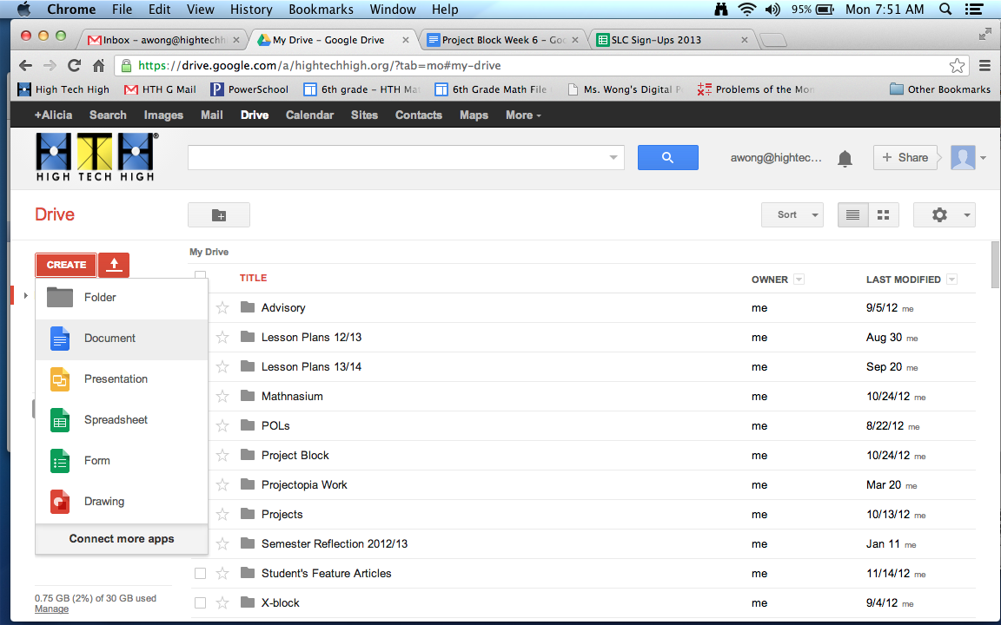
Putting our Questions into our new Themes!
You will be assigned a group and a theme
In your group, create a new Google document
Title this document the name of your group’s theme
Share this document with everyone in your group and Ms. Wong and Ms. Alota

Slide 16
Putting our Questions into our new Themes!
Your group will get a blank envelop, write down your group’s theme on the front
In the cup on your desk, look for questions that fit into your theme
Write those questions down in your google doc.
Place those questions into your group’s envelope
After you go through all of the questions, put the left over questions back into the cup and write down the cup’s number on your envelope.
Hold up your cup

Slide 17
Pop Quiz
What will you title your Google Doc?
Who will you share this document with?
What will you do with the questions that fit into your theme?
Which questions will you put into your envelope?
Where will you put the questions that DO NOT fit into your theme?
How will your teachers know that you are done with that cup?

Slide 18
Themes Groups
Future #1 Bailey Hasan | Future #2 Kamryn Gabriel | Education #1 Sophia C. Chris | Fundamental Needs Sophia L. Lindsey
Biology #1 Caroline Melanie | Biology #2 Michael Kendall | The End #1 Jermaine Dani | The End #2 Makayla Alex
The Universe Matthew K. Treat | Entertainment Ruth Jacky | Government David Aidan Parral | Philosophy Zack Pablo
Psychology #1 Lianna Krimsynn | Psychology #2 Kat Natalie A. | Physical Science #2 Andre Ozanei | Unknown Mysteries Adrian Ivanette
History Esme Nataly L. | Future Brandon Tiera | Earth Science #1 Matthew L. Brian | Earth Science #2 Shane Nadia
Issues #1 Sydney Kyna | Issues #2 Inika Jamie | Culture Xander Sondre | The Human Body Sammy Angelo
Physical Science #1 Alexis Claire | Technology #1 Aiden Pinedo Kai | Technology #2 Aaron Justin Dev

Slide 19
Collaborative Design
What are our next steps in designing our project?
We’ve got to select a theme!

Slide 20
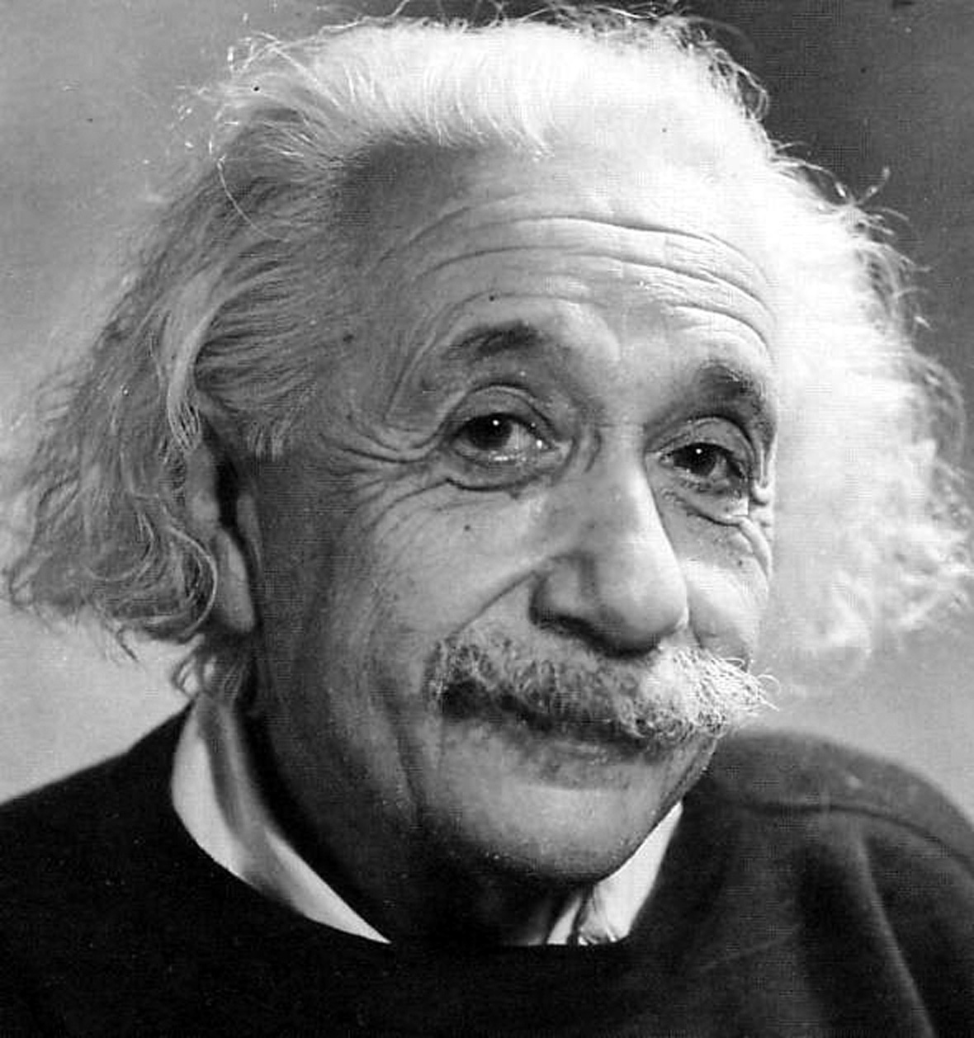
What is the most fair way to select a theme?
Using math, we can prove which themes have the most support.
At your tables, figure out the most mathematically fair way to find out which themes have the most support!

Slide 21
In your Problem-Solving Notebook…
Explain how to mathematically prove which themes have the most support
Based on the survey data, figure out which themes have the most support

