Slide 1
Multiplying Fractions

Slide 2
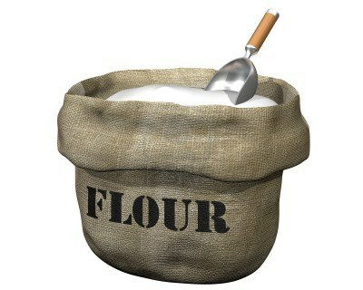
Warm-Up
I need to cut a recipe in half. What is ½ of ¾ of a cup of flour?
*Hint: draw a picture to help you!
*Hint: OF is a key word!

Slide 3
Why?
When you multiply fractions you are turning one of the fractions into a “whole” and cutting out a piece of it (the other fraction)
0 1/8 2/8 3/8 4/8 5/8 6/8 7/8 1
0 ¼ ½ ¾ 1

Slide 4
Multiplication
When you multiply a number by a number greater than one, you get a bigger number
When you multiply a number by 1, you get the same number
When you multiply a number by a number less than one, you get a smaller number

Slide 5
Warm-Up
The following two problems have the same answer. Solve each of the problems and then explain in 2-3 sentences why you think their solutions are the same.
8÷2= 8x½=

Slide 6
So what’s the rule?
Rule: When we multiply fractions, we multiply the numerators together and the denominators together.

