Slide 1
The homework discussion…
Who is correct?
Jim: 4 + 2 × 3 = 6 × 3 = 18
Juan: 4 + 2 × 3 = 4 + 6 = 10

Slide 2
Rules to live by…
Hear ye, hear ye… from this day forward we shall follow these rules while performing more than one arithmetic operation in a problem…
Do EVERYTHING inside parentheses
Simplify exponents
Multiply AND divide from left to right…
Add AND subtract from left to right…

Slide 3
Practice Problems…
(3 + 1)³ × 2 + 4 × (20 – 15)
4² × (2 + 3) × (21 – 16) ²
(2 + 4)² × 2 + 3 × 4 ÷2

Slide 4
Flocabulary
http://www.youtube.com/watch?v=zanq7gmXY88

Slide 5
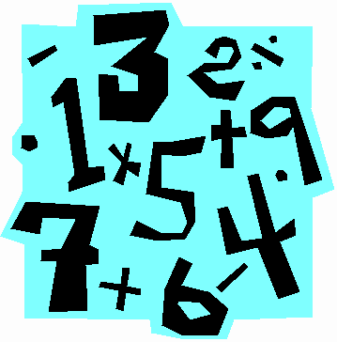
Warm-up 36
Order of Operations GONE CRAZY!!!
Use the “Rules to live by” to solve this problem correctly. Have fun!!! ☺
(3 + 1)³ × 2 + 4 × (20 – 15)² × 2³ + 4 × (20 + (10 x 3 + 2)) + (-7)¹
If you have time, write your own CRAZY problem and give it to your neighbor!

Slide 6
Warm-up 37
Order of Operations GONE CRAZY!!!
Use the “Rules to live by” to solve this problem correctly. Have fun!!! ☺
(4 + 1)² × 3 + (-4) × (20 – 19)² × 2³ + (-20 + (10 x 4 + (-2)))
If you have time, write your own CRAZY problem and give it to your neighbor!

