Slide 1
PERCENT means…
Per 100
OR
out of 100

Slide 2
With your partner, discuss…
What does it mean to have a percent that is over 100? Does 200% make sense? In what situation?
Suppose I asked you to plot percents on a number line. Could you do it? Where would they go? Draw a number line and label it with 50%, 100%, 25%, and 10%.

Slide 3
Working with percents:
Percents are a RATIO out of 100.

Slide 4
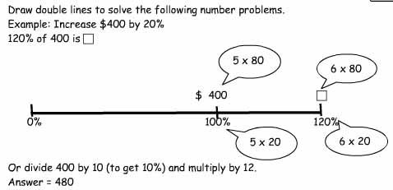
Since a percent is a ratio....
We can use our old friend the double number to solve them…

Slide 5
Since a percent is a ratio....
We can also use our old friend ratio table to solve them!
Example 2: What is 20% of 50?
Percent | 0 | 100% | 50% | 20%
Part and Whole | 0 | 50 | 25 | 10

