Slide 1

Ratios…
A ratio shows a relationship between two or more quantities.
They can be written as…
1. As a FRACTION!
Ratio of boys to girls is 1/3
2. With a colon
Ratio of boys to girls is 1:3
3. With the word “to”, "for every", or "out of every"
Ratio of boys to girls is 1 to 3, 1 girl for every 3 boys...

Slide 2
Ratios…
Ratios can be...
Part to Part:
Boys to girls
Part to Whole:
Boys to the whole class
Girls to the whole class

Slide 3
Right now:
What is the ratio of people wearing blue and people who are not wearing blue at your table?
What is the ratio of people who speak another language and people who do not speak another language at your table?

Slide 4
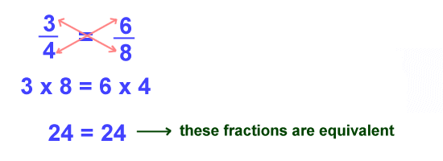
Equivalent Fractions
¾ of the people at our table are wearing blue. How many people are wearing blue at our table and the table next to us?
?
=

Slide 5
Setting up Proportions
What is the proportion in this situation?
1. ½ of the people at our table have brown hair. How many people in our class have brown hair?
2. ⅓ of the people at our table are left-handed. How many people in our class are left-handed?
?
?
=
=

Slide 6
1/28/13 Warm-Up
Solve:
¼ of the people at our table prefer the color blue. Predict how many people in the whole class will prefer blue?
?
7
=
Then answer: Why do we use proportions?

Slide 7
Cross Multiplying
?
×
Answer:
9
=
÷
=
STEP 1: Multiply the numbers that are diagonal from each other
STEP 2: Divide your answer by the other number

Slide 8
Cross Multiplying
?
×
Answer:
12
=
÷
=
STEP 1: Multiply the numbers that are diagonal from each other
STEP 2: Divide your answer by the other number

Slide 9
Warm-Up: Mangoes
A store was selling 8 mangos for $10 at the farmers market.
Tionna said, “That means we can write the ratio 10 : 8, or $1.25 per mango.”
Hunter said, “I thought we had to write the ratio the other way, 8 : 10, or 0.8 (4/5) mangos per dollar."
Can we write different ratios for this situation? Explain why or why not.

Slide 10
Rate…
A rate is a special ratio in which the two terms are different units
Examples:
I drove 120 miles in 2 hours
  The rate is 120 miles/2 hours
Apples cost $1.69 for 3 pounds
  the rate is $1.69/3 pounds .
I earn $800 in each 40 hour work week
  The rate is $800/40 hours

Slide 11
Unit Rate…
A rate that has a ONE on the denominator
I drove 120 miles in 2 hours
  How many miles did I drive in 1 HOUR?
Apples cost $1.69 for 3 pounds
  How much is 1 POUND of apples?
I earn $800 in each 40 hour work week
  How much money do I make in 1 HOUR?

Slide 12
Double Number Lines
Double number line diagrams are best used when the quantities have different units.
Double number line diagrams can help us to see that there are infinitely many pairs of numbers in the same ratio, even fractions or decimals!

Slide 13
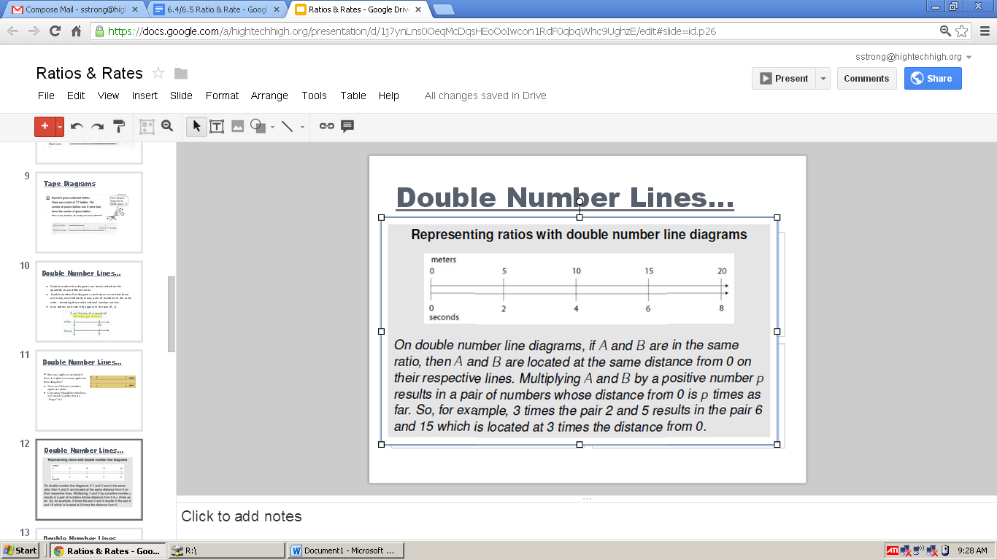
Double Number Lines
How long does it take the runner to run 15 meters?
How many meters can the runner run in 4 seconds?
How long would it take for the runner to run 25 meters?

Slide 14
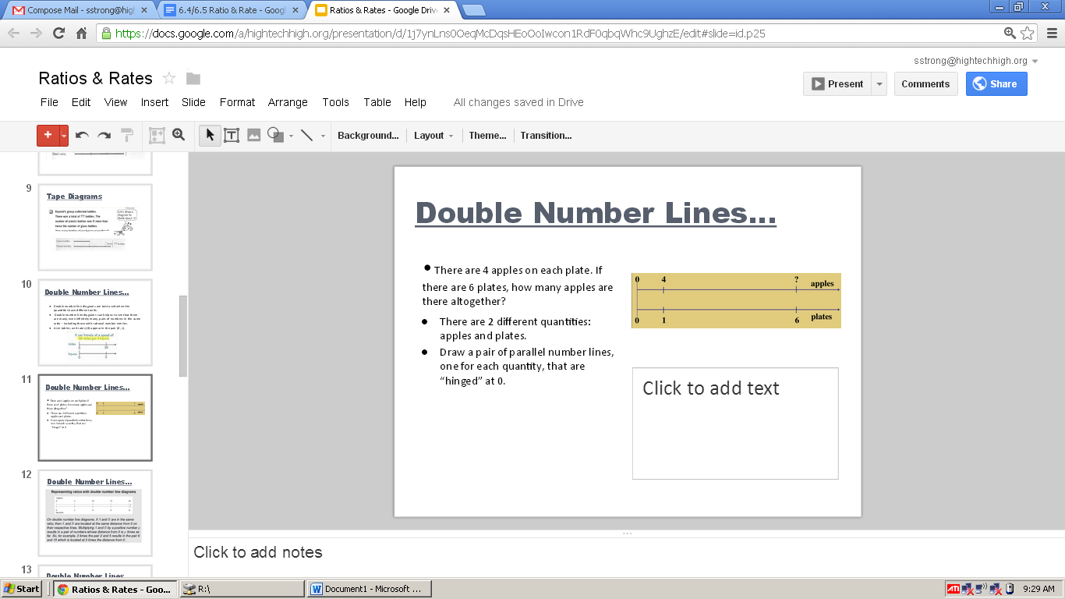
Double Number Lines
If there are 6 plates, how many apples are there altogether?
If you had 3 plates, how many apples would there be?

Slide 15
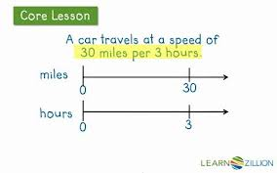
Double Number Lines
At what rate is the car moving (every 1 hour)?
How many hours will it take for them to drive 50 miles (you may need to estimate)?

