Slide 1
Statistics
Although you will encounter many fields of math (algebra, geometry, trigonometry, even calculus!) during your life, statistics is the field that you will likely encounter most often. In reality, we are exposed to statistics every single day!

Slide 2
Statistics Key Words

Slide 3
Statistics
The practice of collecting and analyzing numerical data for the purpose of better understanding a certain group of people or population

Slide 4
Data
Facts and information collected together to try to learn something new!

Slide 5
Population
The complete set of individuals from which data is collected.
Name the population:
Shaddox/Wong students’ favorite food
Average height of 12 year olds
Math grades of middle school females in the HTH Village.

Slide 6
Sample
A portion, piece, or segment of the individuals from which data is collected... because sometimes you can't ask everyone!!!

Slide 7
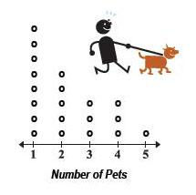
Dot Plot
A graph where each piece of data is shown as a dot above the number line.

Slide 8
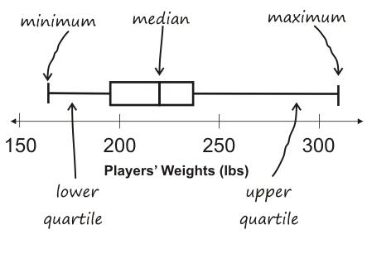
Box Plot
A graph that visually displays the data using median, quartiles and extremes on a number line!

Slide 9
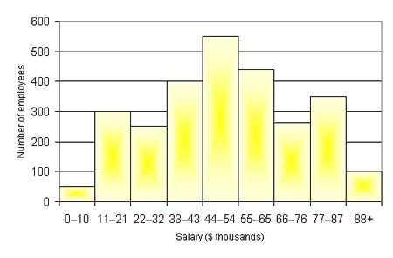
Histogram
A data display where the labels for the bars are in numeric intervals.

Slide 10
Distribution of Data/Overall Shape
The shape the data makes when it is placed on a number line or graph.
The graph will often have a “cluster” of data in one area, a "gap" of data in another place, and sometimes an "outlier", or piece of data that is much larger or smaller than the other numbers.

Slide 11
Center of Data
The middle of the data expressed with a single number.
here are two great ways to do this...
1. Mean: The "mean" is the "average" you're used to, where you add up all the numbers and then divide by the number of numbers.
2. Median: The "median" is the "middle" value in the list of numbers. To find the median, your numbers have to be listed in numerical order, so you may have to rewrite your list first.

Slide 12
Mean
Maricela received the following grades on her quizzes:
To find the mean (average), we add up all the numbers and then divide by the number of numbers.
Quiz Grades
8 | 9 | 7 | 10 | 9
8+9+7+10+9
5
=
43
5
=
8.6

Slide 13
Median
Quiz Scores
8 | 9 | 7 | 10 | 9
To find the median, your numbers have to be listed in numerical order, so you may have to rewrite your list first.
7 | 8 | 9 | 9 | 10
What word sounds like median?
MIDDLE!
We have to find the middle number of our data.

Slide 14
Median
What if we have an even number of numbers? There is no “middle.”
Quiz Score
7 | 8 | 9 | 10
Find the mean of the TWO middle numbers:
8+9
2
17
2
=
=
8.5

Slide 15
Mode
The “mode” is the number in a set of data that appears most often.
Quiz Grades
8 | 9 | 7 | 10 | 9
Find the mode for Maricela’s test scores.
Mode = 9

Slide 16
Spread/Variation
A way to look at how spread out the data is...
Range: The “range” is the difference between the largest and smallest number in the list.
Mean absolute deviation: An average of how far each data point in a set is from the mean of the set of data.

Slide 17
Range
The “range” is the difference between the largest and smallest number in the list.
Quiz Grades
8 | 9 | 7 | 10 | 9
Largest = 10
Smallest = 7
10 – 7 = 3
Range = 3

Slide 18
Mean Absolute Deviation
Step 1: Find the mean of the set of data.
Step 2: Determine the deviation or difference of each number in the data set from the mean.
Step 3: Find the absolute value of each deviation from Step 2.
Step 4: Find the average of the absolute deviations from step 3.
Quiz Grades
8 | 9 | 7 | 10 | 9
Mean = 8.6
8.6 – 8 = 0.6
8.6 – 9 = -0.4
8.6 – 7 = 1.6
8.6 – 10 = -1.4
8.6 – 9 = -0.4
|0.6| = 0.6
|-0.4| = 0.4
|1.6| = 1.6
|-1.4| = 1.4
|-0.4| = 0.4
0.6 + 0.4 + 1.6 + 1.4 + 0.4
5
= 0.88

Slide 19
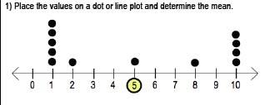
Alternate method for mean absolute deviation

